Slide 1
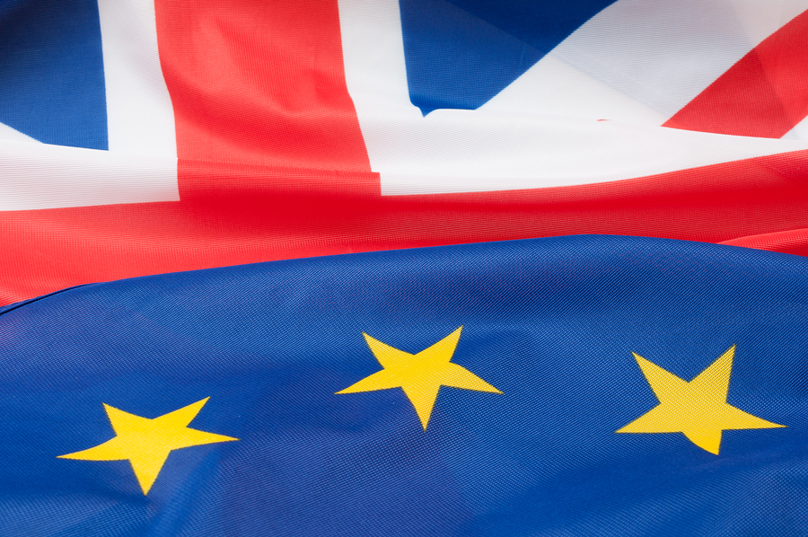
Better Off Out
Why the UK will be more prosperous, more democratic and more influential by leaving the EU
Presentation by the Rt Hon John Redwood MP

Slide 2
Better for Business
The UK can negotiate her own free trade agreements with the USA, China, India and other leading countries – after 43 years in an EU that failed to do so
The UK can decide which rules and regulations to impose on all UK internal business and all exports to non EU countries
The UK will continue to trade with the rest of the EU, and they will not impose additional tariff barriers on their trade with us
The UK will avoid new and higher taxes on business – the Financial Transaction Tax, VAT and Corporation Tax

Slide 3
Better for people
The UK can decide whether to enjoy a £300 a year per family tax cut, or to increase public spending as we will save £10 billion on our net contribution to the EU
The UK government can guarantee all EU payments to farmers, Universities etc. out of the savings from our gross contribution to the EU
The UK could pursue a cheaper energy policy, taking people out of fuel poverty and aiding the industrial recovery of the UK.

Slide 4
A richer country
On leaving we will be £10 billion a year better off – a 0.6% boost to our economy – from the saved net contributions
The UK balance of payments will also improve by £10 billion in the first year from saving the net contribution
There will be further economic gains from negotiating free trade agreements elsewhere, which the EU has stopped us doing
There could be gains to output from simplifying and making regulation more proportionate and risk based

Slide 5
A more influential country
Out of the EU the UK will gain her own seat on the World Trade Organisation and will be free to follow her own approach to freer trade
The UK will gain seats on major standards bodies which set the world standard which in turn inform EU standards
The UK will have her own seat and policy at World summits like the Climate Change summits
The UK will be better treated by France and Germany, who will still want UK support and help for some of their activities

Slide 6
A freer more democratic country
The UK will be able to make her own decisions through Parliament as guided and informed by UK voters
The UK will regain control of her own business, environmental, criminal justice and foreign policies amongst others
Once again we will live in a country where Parliament can change any law it wishes
The UK people will be sovereign again, able to elect people who do their bidding without the interference or prohibition of EU laws

Slide 7
Staying in would be a wild ride to political union
Staying in is not some comfortable status quo with a few clumsy compromises
It is a wild ride to political union, as the rest of the EU tries to put in place the political union their currency union requires
Far from being a ticket to a prosperous market, it is a set of costs and laws that can impede freedom and prosperity

