Slide 1
Can you have a successful currency union without political union?
Presentation by THE RT HON JOHN REDWOOD MP

Slide 2
Break up of currency unions that are not unified countries is common
Ending of the rouble bloc following the break up of the USSR and satellites
Ending of the sterling area
Establishment of an independent currency in Ireland
Break up of Latin and Scandinavian currency unions
Split of Czech Republic and Slovakia

Slide 3
Arguments over sterling union between Scotland and the rest of the UK
Could Scotland keep the pound and be independent?
Support for banking system and banks
Common welfare system
Regional transfer payments
Underwriting revenue risks as with oil revenues
How far can Scotland go with devolution of revenue raising and spending?

Slide 4
Merger of DM and Ostmark
1 to 1 exchange rate
25% of East German workforce moves to West
Euro 80 billion of transfers per annum

Slide 5
Arguments over Greece and Germany
Should the European Central Bank (ECB) stand behind Greek banks?
Should the rest of the Euro area send Greece grants to help with high unemployment and low output?
Do Greece and Germany need similar levels of welfare support?
When is a loan in practice a grant?

Slide 6
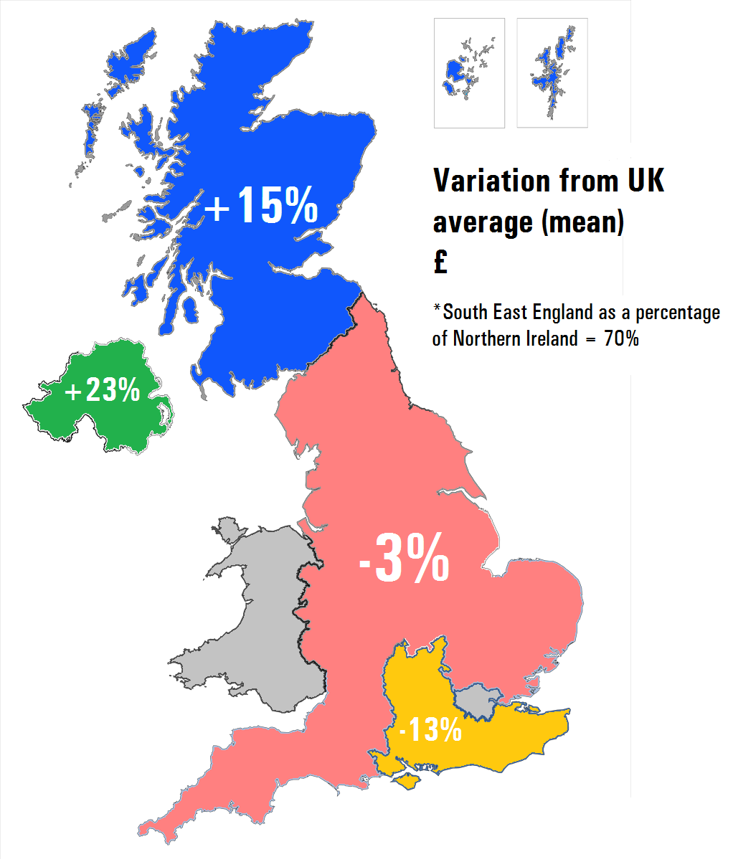
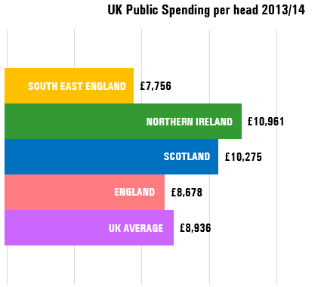
How big do transfers of money need to be?
Table A: UK Public Spending per head 2013/14
Table B: Variation from UK average (mean) £

Slide 7
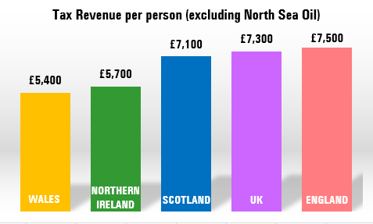
UK regional pattern of revenue raising
Table C: Tax Revenue per person (excluding North Sea Oil) – 20/02/15

Slide 8
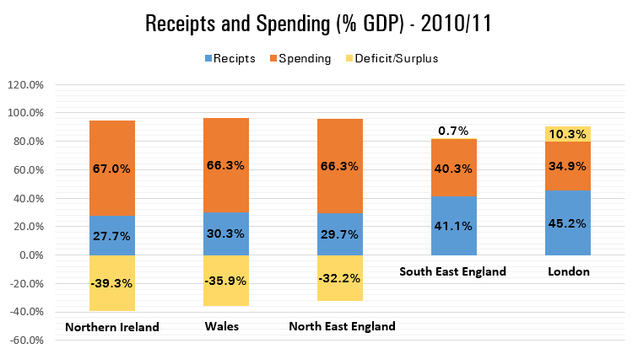
UK level of deficits and surpluses – the contribution of London and the South East to the rest of the country
Table D: Receipts and Spending (% GDP) – 2010/11

Slide 9
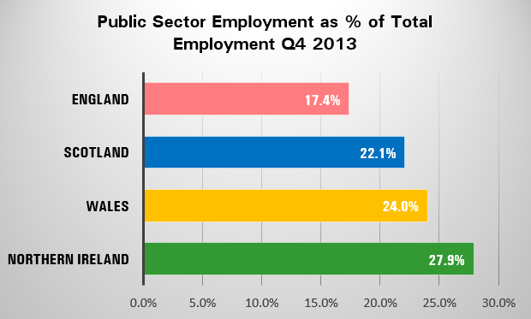
The regional pattern of Public Sector employment
Table E: Public Sector Employment as % of Total Employment Q4 2013

Slide 10
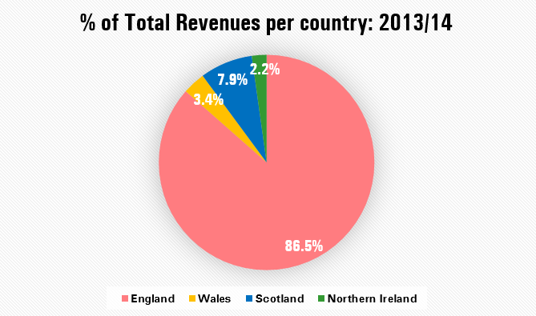
Where does the tax revenue come from?
Table F: % of Total Revenues per country: 2013/14

Slide 11
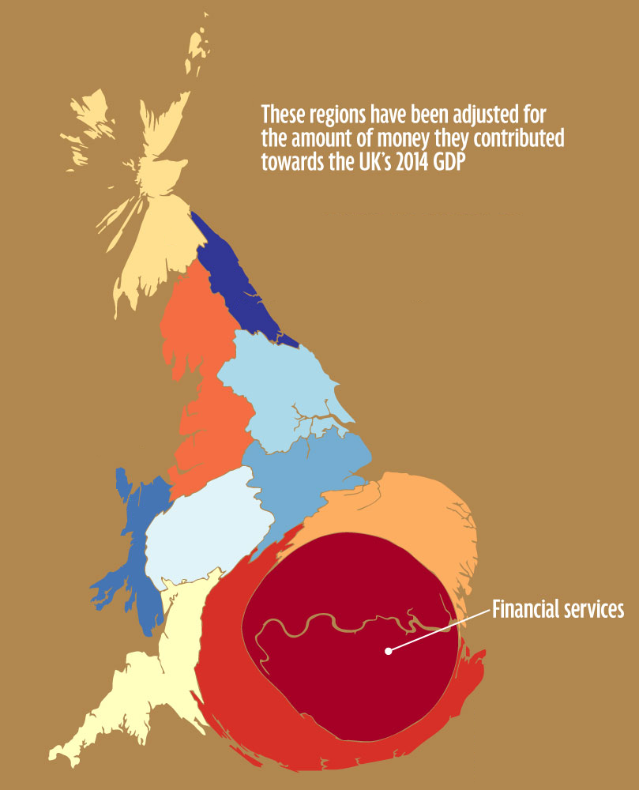
Where does the tax revenue come from?
Table G: Regional GVA Analysis by the Office for National Statistics (2014)

Slide 12
Euro area
Should Greece be allowed to spend and borrow on the scale of Wales or Northern Ireland?
Should Germany pay higher taxes and make a larger contribution on the scale of South East England?
Should Greece be allowed more public sector employment and activity?

Slide 13
Devaluation and competitiveness
Can there be balance of payments deficits and surpluses between Euro area countries?
Are there balance of payments deficits and surpluses between UK regions?
How are surpluses and deficits financed in a single currency?
The cruel logic of internal devaluation verses larger transfer payments

Slide 14
Supporting public spending
The politics of austerity
How cutting welfare and public sector employment without devaluation and private sector monetary expansion makes you poorer
Should Greece be allowed to run a larger deficit?
Should the rest of the EU help pay for Greece’s welfare?

Slide 15
Banking union
The ECB as bank regulator
Capital adequacy and recapitalisation of banks
Austerity politics within a single currency can lead to collapse in asset values and further banking weakness
The Cypriot experience in the Euro

Slide 16
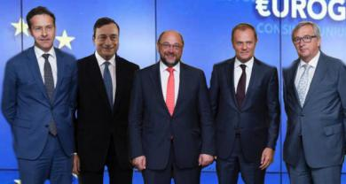
The Five Presidents remedy
Economic Union
Monetary Union
Capital Markets Union
Banking Union
Single Market
Freedom of Movement
Political Union
Image of the Five Presidents: Jeroen Dijsselbloem, Mario Draghi, Martin Schulz, Donald Tusk and Jean-Claude Juncker.

Slide 17
Why you also need a transfer union
Revenue risk sharing in the Euro area
Getting closer to common standards of living
Common welfare benefits?
Transfers for welfare, tax risk sharing and regional policy

Slide 18
Half sovereign countries
Euro area countries
The SNP model for Scottish Independence

Slide 19
How serious are the main regional nationalist movements in the EU?
Catalan nationalism
Scottish nationalism
Padanian/Venetian nationalism
Flemish nationalism
Basque nationalism

Slide 20
The paradox of recent events
Greece busy being pushed into political union to make her single currency work
Greece has surrendered control of her taxes, spending and banking system
Scotland pushing to un-pick the political union which lies behind the currency union, but says it wants to stay in the currency union

Slide 21
Why you cannot have a single currency without political union
The important decisions on:
Level of debt
Increase in debt
Taxes
Spending
Banking regulation
Money growth
All have to be made together to work

